Slide 1
JOIN
by wwy

Slide 2
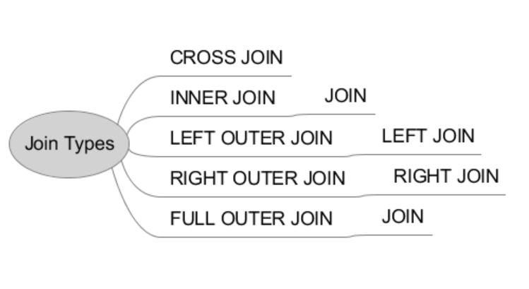

Slide 3
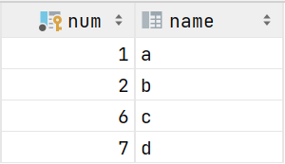
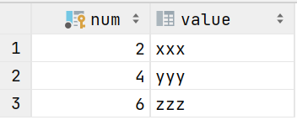

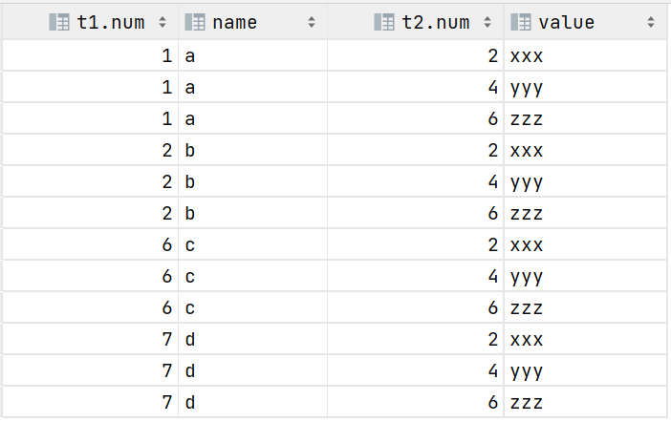
CROSS JOIN

Slide 4


JOIN

Slide 5

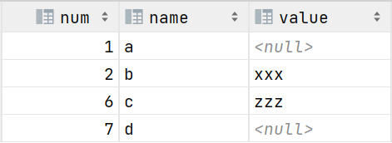
LEFT JOIN

Slide 6


RIGHT JOIN

Slide 7

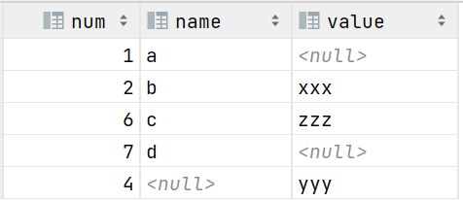
FULL JOIN
left
right

Slide 8
THX :-)

